Slide 1
Round Robin Algorithm
Presenter Name:
V. Naveen
b. Rama Koti reddy
Ch. Akhil

Slide 2
What is Round Robin Algorithm?
Round robin is a scheduling algorithm used in computing and data communication systems. It involves processing tasks or data sequentially, where each task or unit of data is assigned to a resource in a circular manner. This ensures that each resource gets an equal share of processing time or data access.

Slide 3
Characteristics of Round Robin scheduling
A pre-emptive scheduling algorithm
CPU shifts to next process after a fixed time interval known as time quantum or time-slice
Pre-empted process are added to the end of the queue
A hybrid and clock-driven model
Time slice is usually the minimum but differs from OS to OS.
Oldest , fairest, and easiest algorithm
Widely used in traditional OS.

Slide 4
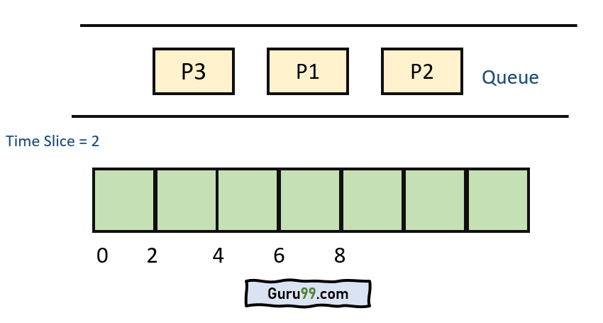
Examples of Round Robin Algorithm

Slide 5
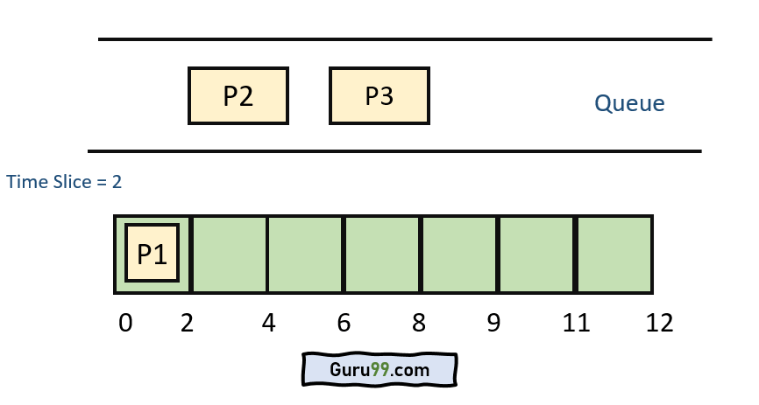
Step 1) The execution begins with process P1, which has burst time 4. Here, every process executes for 2 seconds. P2 and P3 are still in the waiting queue

Slide 6
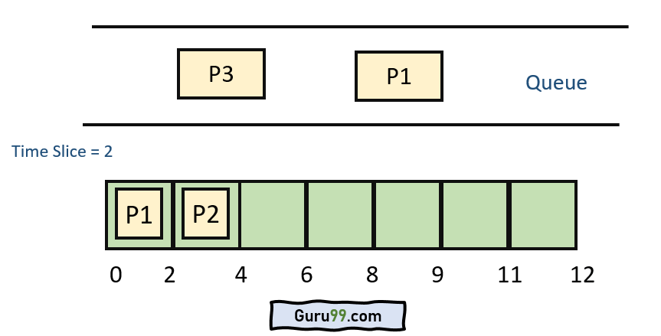
Step 2) At time =2, P1 is added to the end of the Queue and P2 starts executing

Slide 7
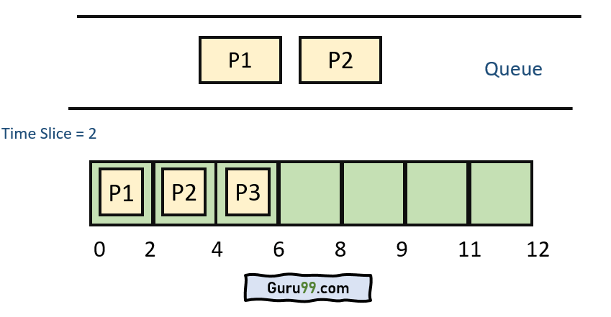
Step 3) At time=4 , P2 is preempted and add at the end of the queue. P3 starts executing.

Slide 8
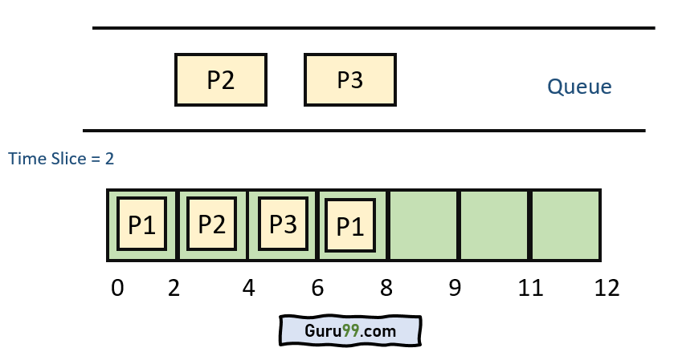
Step 4) At time=6 , P3 is preempted and add at the end of the queue. P1 starts executing.

Slide 9
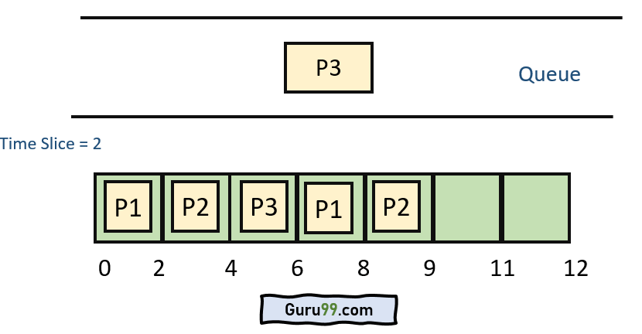
Step 5) At time=8 , P1 has a burst time of 4. It has completed execution. P2 starts execution

Slide 10
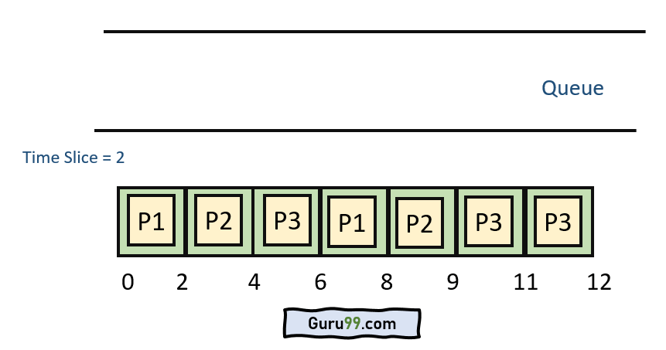
Step 6) P2 has a burst time of 3. It has already executed for 2 interval. At time=9, P2 completes execution. Then, P3 starts execution till it completes.

Slide 11
Step 7) Let’s calculate the average waiting time for above example.
Wait time
P1= 0+4= 4
P2= 2+4 = 6
P3= 4+3= 7

Slide 12
Advantages of Round Robin Scheduling
It provides fairness by giving each process an equal share of the CPU time in a cyclic manner.
Round robin scheduling typically has low latency because processes are served in a predictable order, ensuring that no process waits too long for CPU time.
It's relatively easy to implement compared to other scheduling algorithms like priority scheduling or shortest job next (SJN).
Round robin scheduling is well-suited for time-sharing systems where multiple users are accessing the system concurrently.

Slide 13
Dis-advantages of Round Robin Scheduling
Processes with short bursts of CPU time may be delayed due to the fixed time slices allocated to each process.
It might not be the most efficient scheduling algorithm when dealing with processes with vastly different CPU time
In scenarios where there's high variability in process execution times, round robin may lead to poor performance due to frequent context switches.
There's additional overhead associated with managing the ready queue and performing context switches at regular intervals

Slide 14
Worst Case Latency
dt = Denote detection time when a task is brought into the list
st = Denote switching time from one task to another
et = Denote task execution time

Slide 15


